Slide 1
U1M2L2 Potential Energy

Slide 2
Can an object have energy when it is not moving?
You have learned that when an object is in motion is has kinetic energy. Kinetic energy is due to the mass of the object and its speed.
Does an object have any energy when it is at rest?
Suppose you make a slingshot out of a rubber band. You place a nickel in the slingshot, and then stretch the rubber band back. What happens when you release the rubber band? The nickel moves.

Slide 4
If the rubber band was not stretched back and released, the nickel would not have moved.
The rubber band gave energy to the nickel so the nickel could move.
To be able to pass energy to the nickel, the rubber band must have contained energy when it was stretched.
The energy contained in the rubber band is called potential energy.
Potential energy is the energy due to interactions between objects or particles when distance changes.
The amount of potential energy an object has depends on the positions of objects or particles

Slide 5
Potential energy
When you stretch a rubber band, you increase a form of potential energy called elastic potential energy.
Elastic potential energy is energy stored in objects that are compressed or stretched, such as springs and rubber bands.

Slide 6
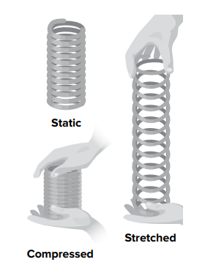
Springs
Springs can contain elastic potential energy.
When a spring is stretched, or compressed, you change its shape. The spring will always try to return to its original resting shape. The more you change its shape, the more potential energy the spring contains.

Slide 8
Systems and Energy
The rubber band and nickel represent a system.
Recall there are two types of systems, open and closed.
In a closed system, the focus is just on the rubber band and the nickel.
In an open system, the environment surrounding the objects is involved. When looking at the energy in a system, identify the components of the system and how those components change.
For example, the farther back a rubber band is stretched, the farther a nickel will move. The rubber band contains more potential energy when it is stretched farther back.
The larger the change in position between the objects, the greater the potential energy.

Slide 9
Types of Potential Energy

Slide 10
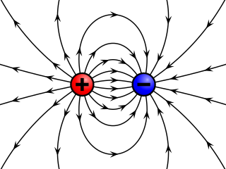
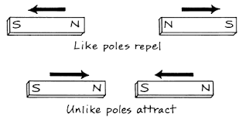
Types of Potential Energy
There are many different kinds of potential energy. These different forms involve different kinds of forces and different kinds of objects.
Gravitational potential energy, electric potential energy, and magnetic potential energy are examples of potential energy due to forces in fields.

Slide 12
How does the distance between an object and Earth’s surface affect the potential energy of the object?
If you throw a ball up, the ball will fall back down. The ball falls because it is in Earth’s gravitational field.
There is gravitational attraction between the ball and Earth. Once the balls falls it is moving and has kinetic energy. Did the ball have energy before it fell?
Energy can be present even if objects are not moving. When you hold a ball, energy is stored between the ball and Earth. This type of energy is called gravitational potential energy

Slide 14
Gravitational Potential Energy
Objectives
* Identify gravitational potential energy
Discuss factors that affect potential energy
Illustrate real life examples

Slide 15
Ali was going outside the building , when he suddenly realized that he forgot his bag , he asked his sister to throw it for him ? Is this safe ? Try Using scientific words to explain

Slide 16
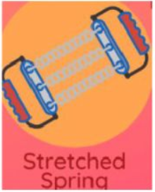

Slide 17
ELASTIC
GRAVITATIONAL
POTENTIAL ENERGY
CHEMICAL
ELASTIC
CHEMICAL
CHEMICAL

Slide 18
Gravitational Potential Energy
Gravitational potential energy is stored energy due to the distance above Earth ( height ) .
Gravitational potential energy exists between all objects but is only significant between objects and Earth.

Slide 19
Factors affect potential energy
https://phet.colorado.edu/sims/html/energy-skate-park/latest/energy-skate-park_en.html

Slide 20
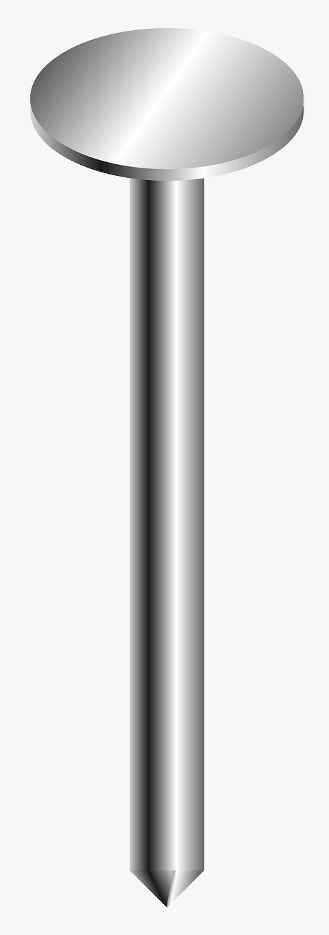
Same mass

Slide 22
potential energy and height
When you lift the backpack, you exert a force on the backpack that is opposite the force of gravity. The application of this force increases the energy of the backpack.
The potential energy of the backpack increases as its height increases
Gravitational potential energy and height have a direct proportional relationship.

Slide 25
potential energy and mass
Look at the picture. Notice that the potential energy of the backpack increases as its mass increases.
Gravitational potential energy and mass have a direct proportional relationship.

Slide 26
Which figure/s represent/s a direct relationship ?

Slide 27
Which figure represents a direct relationship ?

Slide 30
LIVE WORKSHEETS
https://www.liveworksheets.com/worksheets/en/Science/Energy/Is_it_Potential_or_Kinetic_Energy_op2499119hj

Slide 31
RANK THE POINTS FROM GREATEST TO LEAST G.P.E
A
B
C

Slide 32
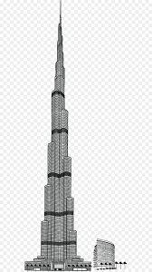
163 floors
830 m to tip
Which causes more damage ?
Ball A , Which has mass = 10 kg , when dropped from floor 20 to the ground
OR , Ball B , Which has mass = 40 kg , when dropped from floor 50 to the ground

Slide 34
CONSERVATION OF ENERGY

Slide 36
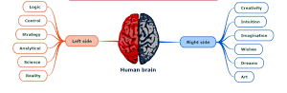
Create your own MINDMAP for G.P.E factors and K.E factors then post on LMS

Slide 37
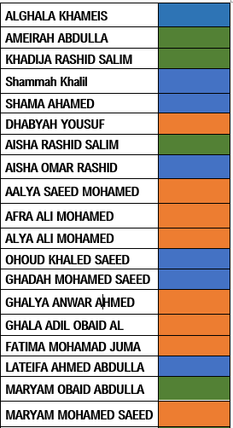
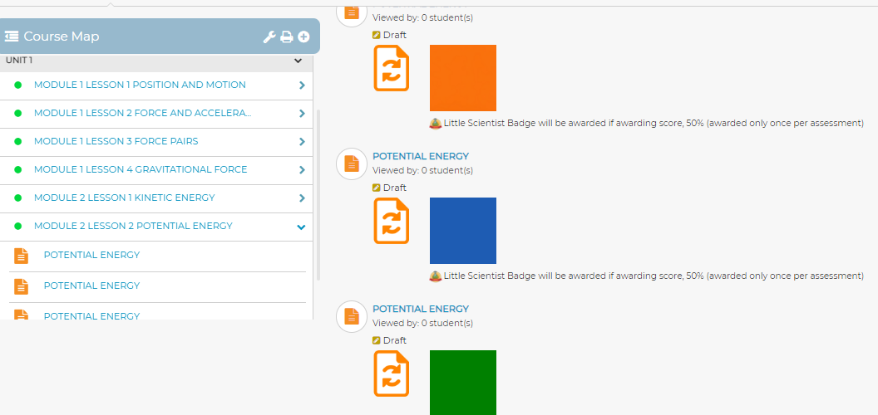
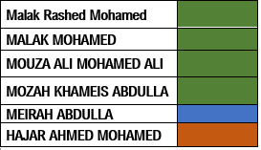

Slide 38
INSPIRE SCIENCE LESSON CHECK

Slide 39
Mass = 50 kg Mass = 70 kg

Slide 40
SAME MASS

